Slide 1
Replacing the Lab Manual with a Learning Management System in Physics Investigations for K-4 Pre-Service Teachers
Stanley Sobolewski
Muhammad Z. Numan
Department of Physics, Indiana University of Pennsylvania, Indiana, Pennsylvania 15705

Slide 2
Objective
Determine if on-line delivery for in-person lab has advantages
  Save paper
  Quick and easy edits
  Possibly immediate feed back for students
  Migration to online only laboratory course

Slide 3

Potential student reaction…
They are digital natives the should like this….

Slide 4
Subjects
Physical Science for pre-service early childhood teachers
Take four course sequence in Physics, Chemistry, Biology and Earth Science
Recently changed to three of the four courses

Slide 5
Specific group
Linked Lecture lab
48 Students – 24 in each lab class
Very homogenous

Slide 6
LMS used is D2L
Desire to Learn – provided by the state system.
We also have Moodle available
  From previous experience, Moodle had a database feature, which was coinvent for student entered data.
  This is lacking in D2L
  Was encouraged to use D2L by support staff

Slide 7
Problem with LMS
LMS cannot receive student data and manipulate the data to determine results
No time or resources to develop our own system
Big Problem

Slide 8
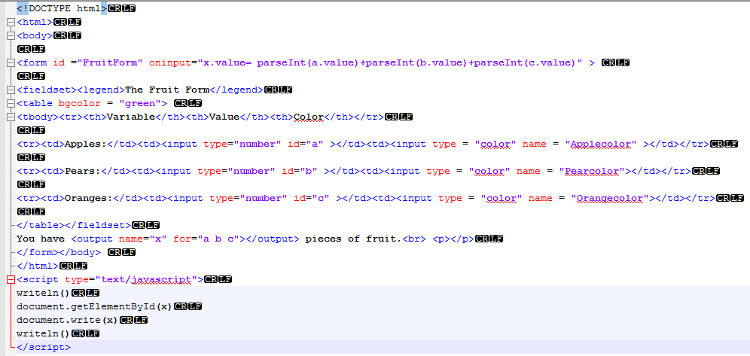
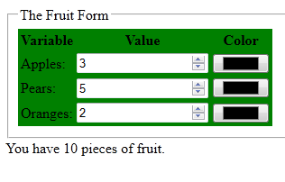
Wrote some html for students to enter data
LMS couldn’t process data

Slide 9
Optics simulation – PhET

Slide 10
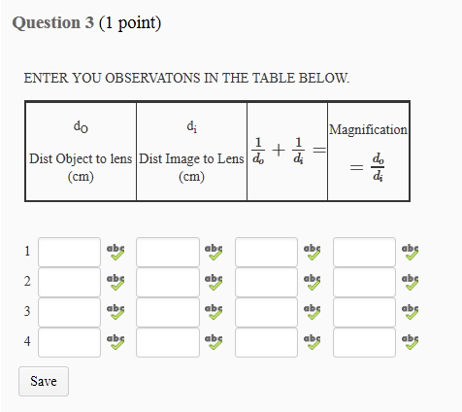
Data table
Students enter data in the “quiz tab”

Slide 11
What did we learn?
14 item MC content quiz
Questionnaire about the preference of on line delivery versus paper and pencil
Counted number of words in student’s answers.

Slide 12
Students write more when keyboarding
Average words per response
Question
“Describe how the magnification changed as you changed the distance from the paper to the lens. Does the magnification get larger or smaller with distance?”
Keyboard | Paper
16 words/answer | 7.5 words/answer
SD = 9.5 | SD = 3.4

Slide 13
Results
The average gain, calculated by dividing the difference between each student’s pre-test and post-test scores by that student's pre-test score was found to be 0.052. The Two-Tailed Sig was 0.869 indicating an insignificant difference.
40% of the student’s scores actually dropped after the laboratory session.

Slide 14
Student Reaction
None of the students felt the computer delivered lab was easier than the paper and pencil lab.
The students felt the paper and pencil delivery was easier to use. 28% felt paper and pencil was much easier and 42% felt paper and pencil was a little easier

Slide 15
What did we learn?
(Not much)
Learning is a wash
Students prefer paper and pencil for this activity
We should continue to develop on line activities
Suggestions?

